Slide 1

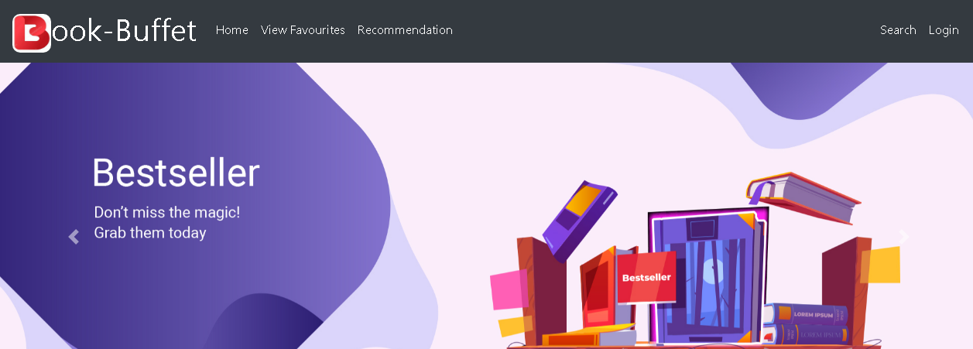

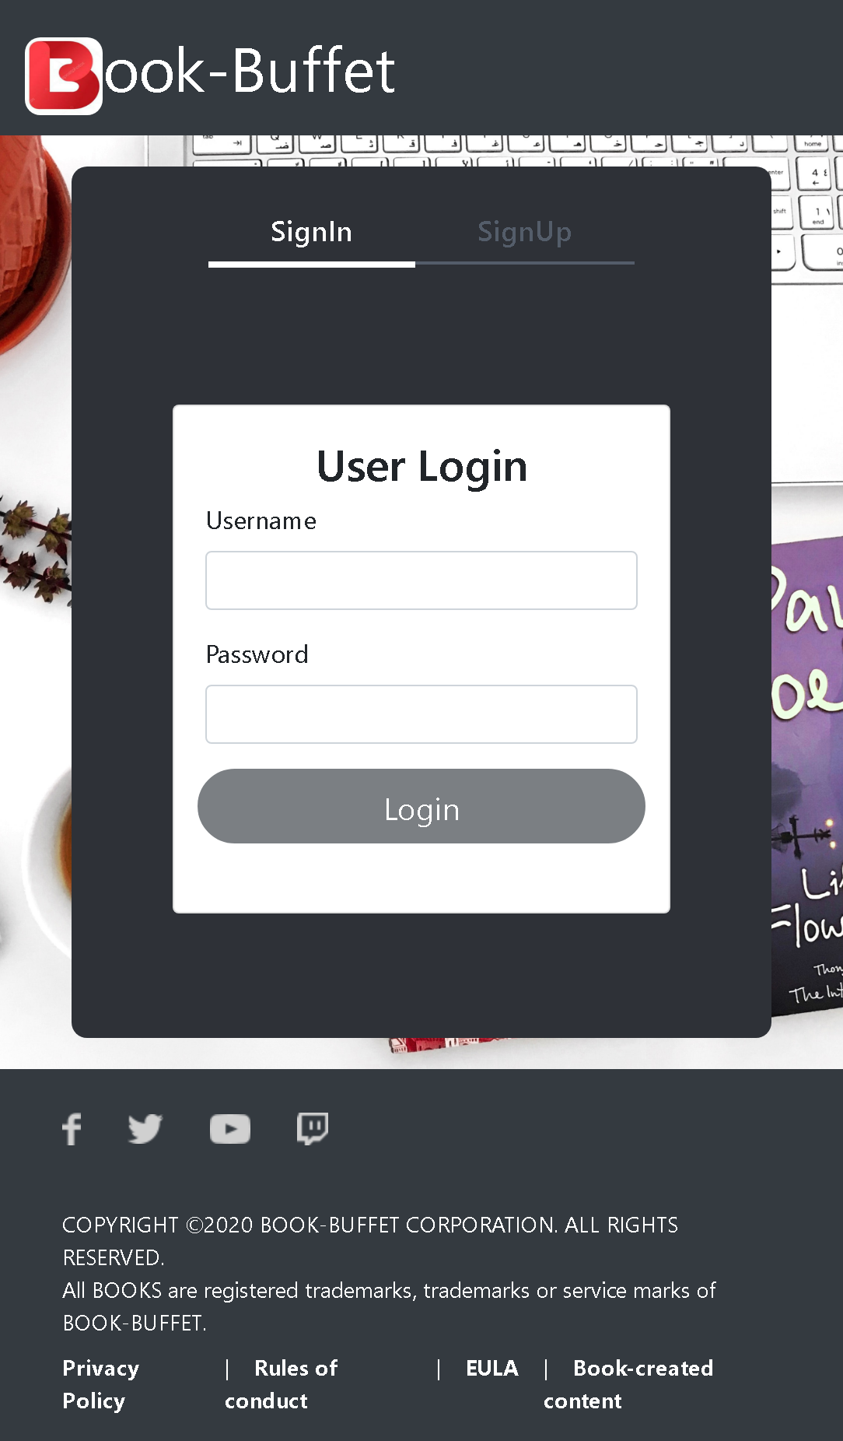
Book-Buffet
Team:
Shivansh Tiwari || Meghana K G || Kavya M V

Slide 2
Outline
Problem Statement
Objective
Microservices
Project Overview
Onboarding-Architecture
Project Flow
Technology and Tools Used
Conclusion

Slide 3

Problem Statement
X is worried as visiting library in this Covid time is not possible.
X wants to access books without stepping outside.

Slide 4
Objective
Our objective is to provide best user experience to X so that X can read books online without stepping outside.

Slide 5
Microservices
Authentication API
Favourite API
Recommendation API

Slide 6
Project Overview

Slide 7
Project Overview
Authentication API
Favourite API
Recommendation API
Favourite
Login
Recommendation
Home
Register
Search
SQL
Server
Mongo
Db
Mongo
Db
External API

Slide 8
Onboarding Architecture

Slide 9
Architecture
Authentication API
JWT validator
SQL Server
Login/Register
POST request
Token generated
Favourite API
Get favourite
Delete favourite
POST /GET/
DELETE
Mongo Db
GET/DELETE
Front End
Angular
GET
Recommendation API
Get Recommends
Mongo Db
GET
Search Book
External API
GET
GET

Slide 10
Project Flow

Slide 11
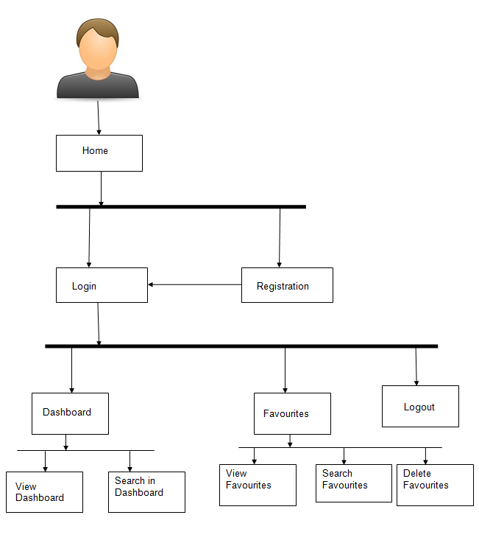
Project Flow
Home
Login
Register
Search
Add to Favourite
Favourite
Recommends
Recommendations
View Favourites
Delete Favourite
View Recommends
Add to Favourite
Search Books

Slide 12








Technologies and Tools Used

Slide 13
Conclusion
The Book-Buffet app helps the user to read books online. It also helps user to
store the favourite books and delete them afterwards.

Slide 14
Thank You

Slide 15


